Slide 1
Ranking-based Processing of SQL Queries
Date: 2012/1/16
Source: Hany Azzam (CIKM’11)
Speaker: Er-gang Liu
Advisor: Dr. Jia-ling Koh

Slide 2
Outline
Introduction
The Core Retrieval Models
TF-IDF
LM Model
Tuple Retrieval
Algorithm SQL-to-PSQL
Basic Views
TF-IDF-based Processing of SQL Queries
LM-based Processing of SQL Queries
Experiment
Conclusion

Slide 3
Introduction
Motivation:
Support document/context and tuple retrieval
“Seamlessly” integrated IR+DB technology
Goal:
Using IR models for processing SQL queries and develops the application of PSQL for tuple retrieval.

Slide 4
Introduction
Typical SQL Query
Properties
Area | Price | Type
LA | 210 | Flat
Texas | 230 | Studio
Florida | 260 | Flat
LA | 225 | Room
Area
LA
Texas
Decompose
areIndex
Area | Type
LA | Flat
Texas | Studio
LA | Room
Index Part
Retrieval Part
Area
LA
Texas

Slide 5
Introduction
Bayes

Slide 6
TF-IDF RSV
c
N_{D}(c) : number of Documents in collection “c”
n_{D}(t,c) : number of Documents with term “t" in collection “c”,
df_{t} : n_{D}(t,c) is the document frequency.
N_{L}(c) : number of Locations in collection “c”
n_{L}(t,c) : number of Locations with term “t".
N_{L}(d) and n_{L}(t,d) : Location-based counts for document “d”,
tf_{d} :=n_{L}(t,d)
d1
t1, t1, t2
d2
t1,t2
d3
t1,t3
d4
t2
TF(t1,d1) = $\frac{2}{3}$
IDF(t1,c) = -log₂ $\frac{3}{4}$

Slide 7
TF-IDF RSV
TF-IDF term weight
weight is defined as follows:
d1
t1, t1, t2
d2
t1,t2
d3
t1,t3
W_{TF-IDF}(t1,d1,t1,c) = $\frac{2}{3}∗\frac{1}{2}$ $∗(\text{−}\text{log}\text{2} \frac{3}{4})$
W_{TF-IDF}(t2,d1,t2,c) = $\frac{1}{3}∗\frac{1}{2}$ $∗(\text{−}\text{log}\text{2} \frac{3}{4})$
d4
t2
Q = t1 ,t2

Slide 8
LM RSV
c
Language modelling (LM)
within-document term probability (foreground model)
P(t1|d1) = $\frac{\frac{2}{3}}{\frac{2}{3}+\frac{1}{3}}$ = $\frac{2}{3}$
Collection-wide term probability (background model).
d1
t1, t1, t2
d2
t1,t2
d3
t1,t3
d4
t2
P(t1|c) = $\frac{\frac{4}{8}}{\frac{4}{8}+\frac{3}{8}+\frac{1}{8}}$ = $\frac{4}{8}$

Slide 9
LM RSV
c
Language modelling (LM)
The LM term weight is defined
as follows:
d1
t1, t1, t2
d2
t1,t2
d3
t1,t3
d4
t2
W_{LM}(t1,d1,c) = log( 1+ $\frac{0.7}{0.3}∗\frac{0.66}{0.5} )$ = 0.611
W_{LM}(t2,d1,c) = log( 1+ $\frac{0.7}{0.3}∗\frac{0.33}{0.375}\text{) }\text{=}\text{ 0.485}$
Q = t1 ,t2
RSV_{LM}(t1,d1,c) = $\frac{1}{2} ∗$ 0.611 + $\frac{1}{2} ∗\text{0.485 }\text{=} \text{0.548}$

Slide 10
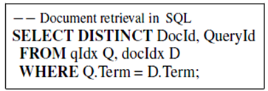
Tuple Retrieval

Slide 11
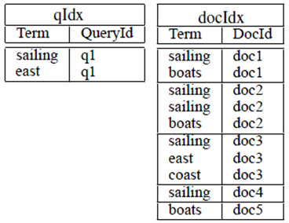
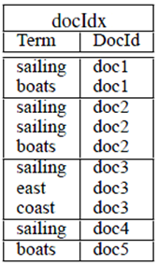
Tuple Retrieval
QueryId | DocId
q1 | Doc1
q1 | Doc2
q1 | Doc3
q1 | Doc4
DocId
Doc1
Doc2
Doc3
Doc4

Slide 12
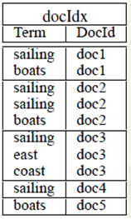
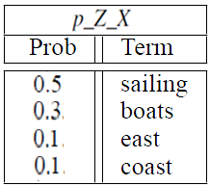
SQL2PSQL ALGORITHM Basic Views
Tuple-based (Location-based) Probabilities, P_Z(X)

Slide 13
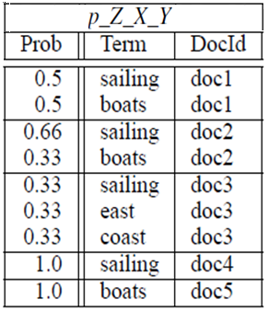
SQL2PSQL ALGORITHM Basic Views
Conditional Probabilities, Pz(X|Y)

Slide 14
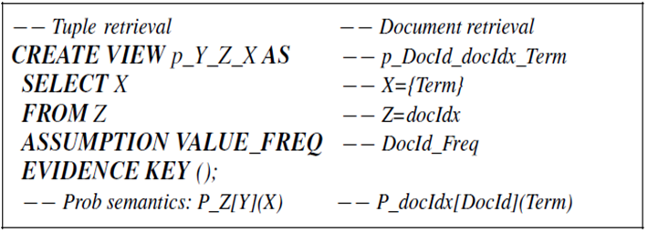
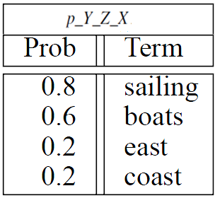
SQL2PSQL ALGORITHM Basic Views
Value-based (Document-based) Probabilities Pz[x](X|Y)

Slide 15
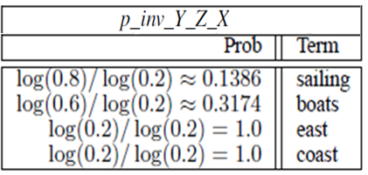
SQL2PSQL ALGORITHM Basic Views
Information-based Probabilities Pz(X infors)

Slide 16
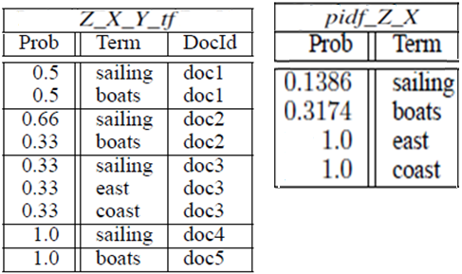
TF-IDF-based Processing of SQL Queries

Slide 17
TF-IDF-based Processing of SQL Queries
0.069 = 0.5*0.1386 | sailing | doc1
0.189 = 0.5*0.3174 | boats | doc1
0.091= 0.66*0.1386 | sailing | doc2
0.105 = 0.33*0.3174 | boats | doc2
0.046 = 0.33*0.1386 | sailing | doc3
0.33 = 0.33*1 | east | doc3
0.33 = 0.33*1 | coast | doc3
0.139 = 1.0*0.1386 | sailing | doc4
0.317 = 1.0*0.3174 | boats | doc5

Slide 18
TF-IDF-based Processing of SQL Queries
0.069 = 0.5*0.1386 | sailing | doc1
0.189 = 0.5*0.3174 | boats | doc1
0.091= 0.66*0.1386 | sailing | doc2
0.105 = 0.33*0.3174 | boats | doc2
0.046 = 0.33*0.1386 | sailing | doc3
0.33 = 0.33*1 | east | doc3
0.33 = 0.33*1 | coast | doc3
0.139 = 1.0*0.1386 | sailing | doc4
0.317 = 1.0*0.3174 | boats | doc5
value1 = saling , value2 = east
0.069 | Doc1
0.091 | Doc2
0.376=0.046+0.33 | Doc3
0.139 | Doc4

Slide 19
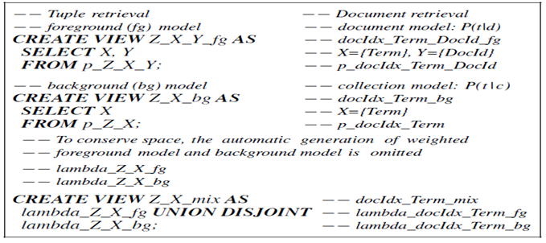
LM-based Processing of SQL Queries
Log(1+1) = Log[ 1+ (0.5/0.5 ) ] | sailing | doc1
Log(1+1.66 ) = Log[ 1+ ( 0.5/0.3 ) ] | boats | doc1
Log(1+1.32) = Log[ 1+ (0.66/0.5 ) ] | sailing | doc2
Log(1+1.1 ) = Log[ 1+( 0.33/0.3 ) ] | boats | doc2
Log(1+0.66 ) = Log[ 1+ (0.33/0.5 ) ] | sailing | doc3
Log(1+3.3 ) = Log[ 1+ (0.33/0.1 ) ] | east | doc3
Log(1+3.3 ) = Log[ 1+ (0.33/0.1 ) ] | coast | doc3
Log(1+2 ) = Log[ 1+ (1.0/0.5 ) ] | sailing | doc4
Log(1+3.33) = Log[ 1+ (1.0/0.3) ] | boats | doc5

Slide 20
LM-based Processing of SQL Queries
value1 = saling , value2 = east
Log(1+1) = Log[ 1+ (0.5/0.5 ) ] | sailing | doc1
Log(1+1.66 ) = Log[ 1+ ( 0.5/0.3 ) ] | boats | doc1
Log(1+1.32) = Log[ 1+ (0.66/0.5 ) ] | sailing | doc2
Log(1+1.1 ) = Log[ 1+( 0.33/0.3 ) ] | boats | doc2
Log(1+0.66 ) = Log[ 1+ (0.33/0.5 ) ] | sailing | doc3
Log(1+3.3 ) = Log[ 1+ (0.33/0.1 ) ] | east | doc3
Log(1+3.3 ) = Log[ 1+ (0.33/0.1 ) ] | coast | doc3
Log(1+2 ) = Log[ 1+ (1.0/0.5 ) ] | sailing | doc4
Log(1+3.33) = Log[ 1+ (1.0/0.3) ] | boats | doc5
0.25 | Doc1
0.33 | Doc2
0.005 =0.165 * 0.033 | Doc3
0.5 | Doc4

Slide 21
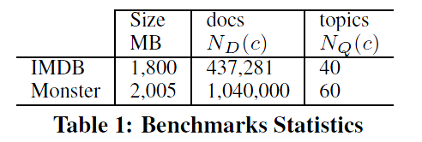
Experiment
The aim is to investigate the implementation of the retrieval models by examining how much quality could be achieved and at what cost.

Slide 22
Experiment - Evaluation
MAP(Mean Average Precision)
Topic 1 : There are 4 relative page‧ rank : 1, 2, 4, 7
Topic 2 : There are 5 relative page‧ rank : 1,3,5,7,10
Topic 1 Average Precision : (1/1+2/2+3/4+4/7)/4=0.83。
Topic 2 Average Precision : (1/1+2/3+3/5+4/7+5/10)/5=0.45。
MAP= (0.83+0.45)/2=0.64。
Reciprocal Rank
Topic 1 Reciprocal Rank : (1+1/2+1/4+1/7)/4=0.83。
Topic 2 Reciprocal Rank : (1+1/3+1/5+1/7+1/10)/5=0.45。

Slide 23
Experiment

Slide 24
Experiment

Slide 25
Conclusion
Support the high-level (abstract) modelling of general and specific retrieval tasks (ad-hoc retrieval, classification, summarisation, structured document retrieval, hypertext retrieval, multimedia retrieval, ...)

